Slide 1
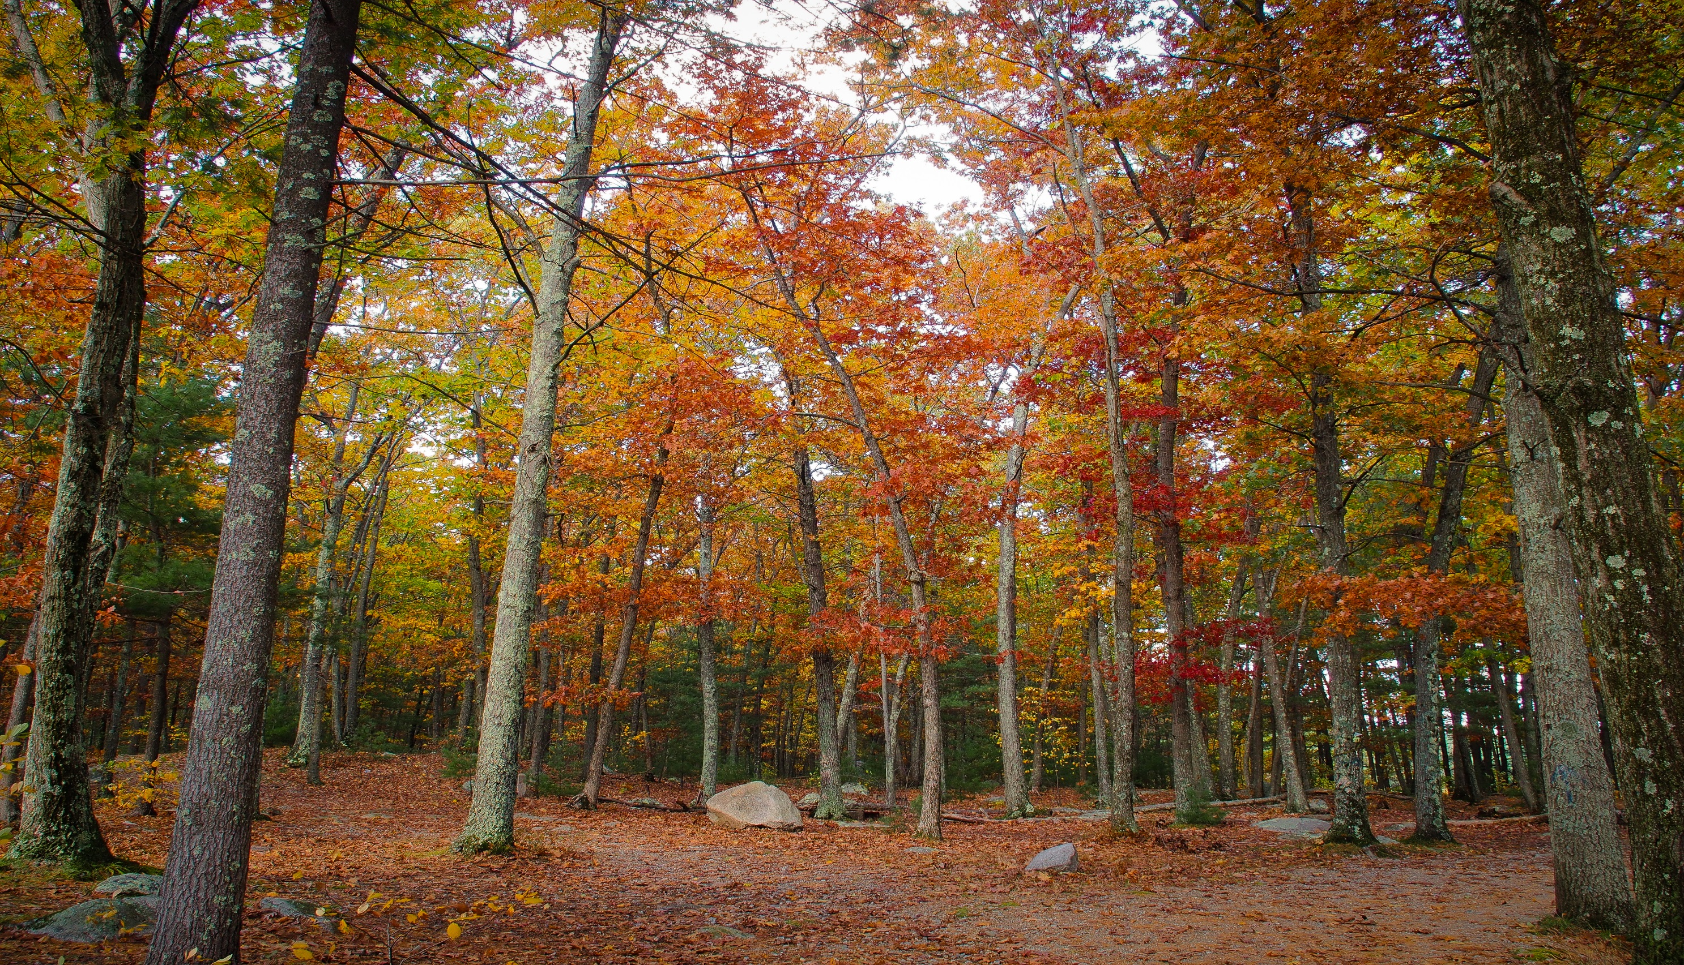
ASHLAND PUBLIC SAFETY BUILDING
MAY 21, 2020

Slide 2
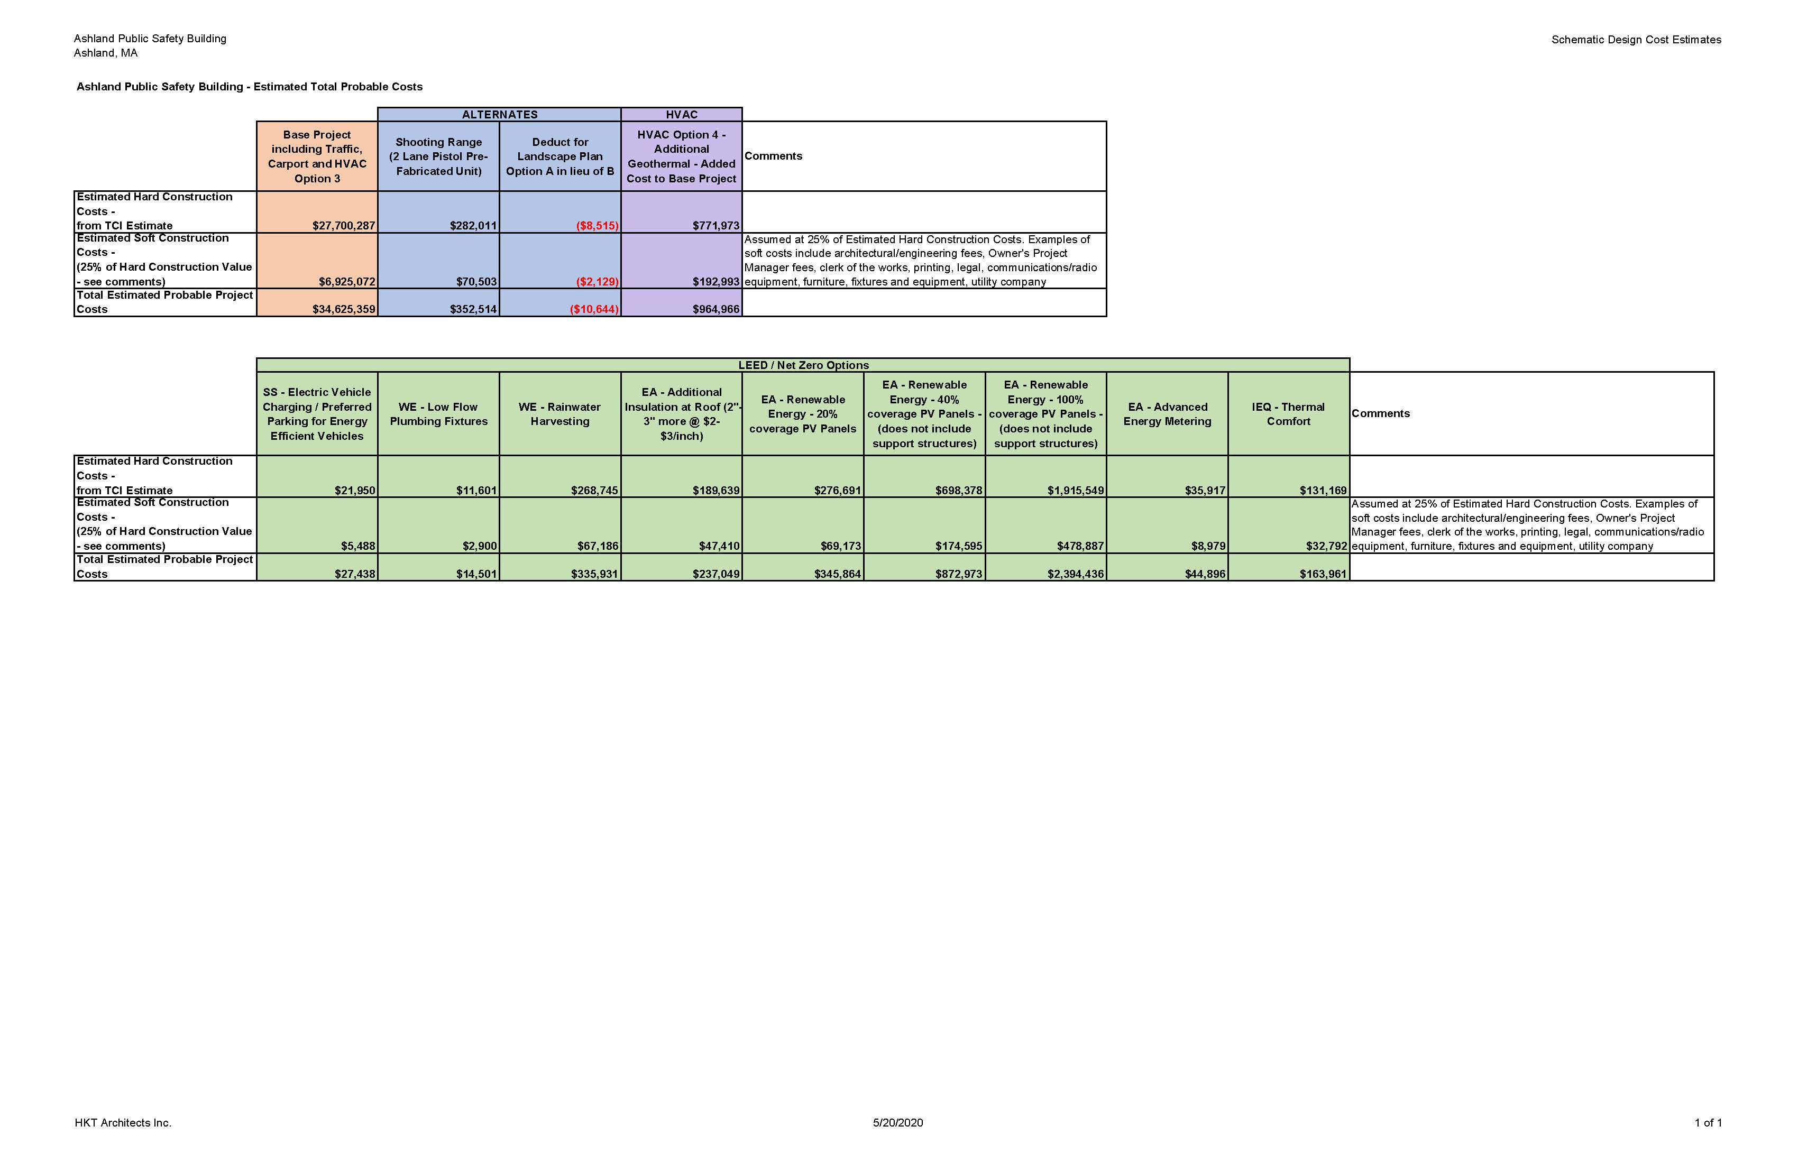
TOTAL PROJECT COSTS
Hard Construction Costs from TCI Estimate
Soft Construction Costs – assume 25% of hard construction (includes Owner’s Contingency)
Total Project Costs

Slide 3
TOTAL PROJECT COSTS
Most recent budget summary – Tri-Board Meeting - $34,171,005 Total Project Costs
Hard Construction Costs Base Costs include items not in previous budgets
  Carport and Covid-19 procedures for construction
Shooting Range – assumes prefabricated unit - 2 lanes for pistols only (rifles increase cost) – based on estimate ranges from manufacturer
Landscape optional design
HVAC Option 4 adds geothermal to Option 3 design

Slide 4
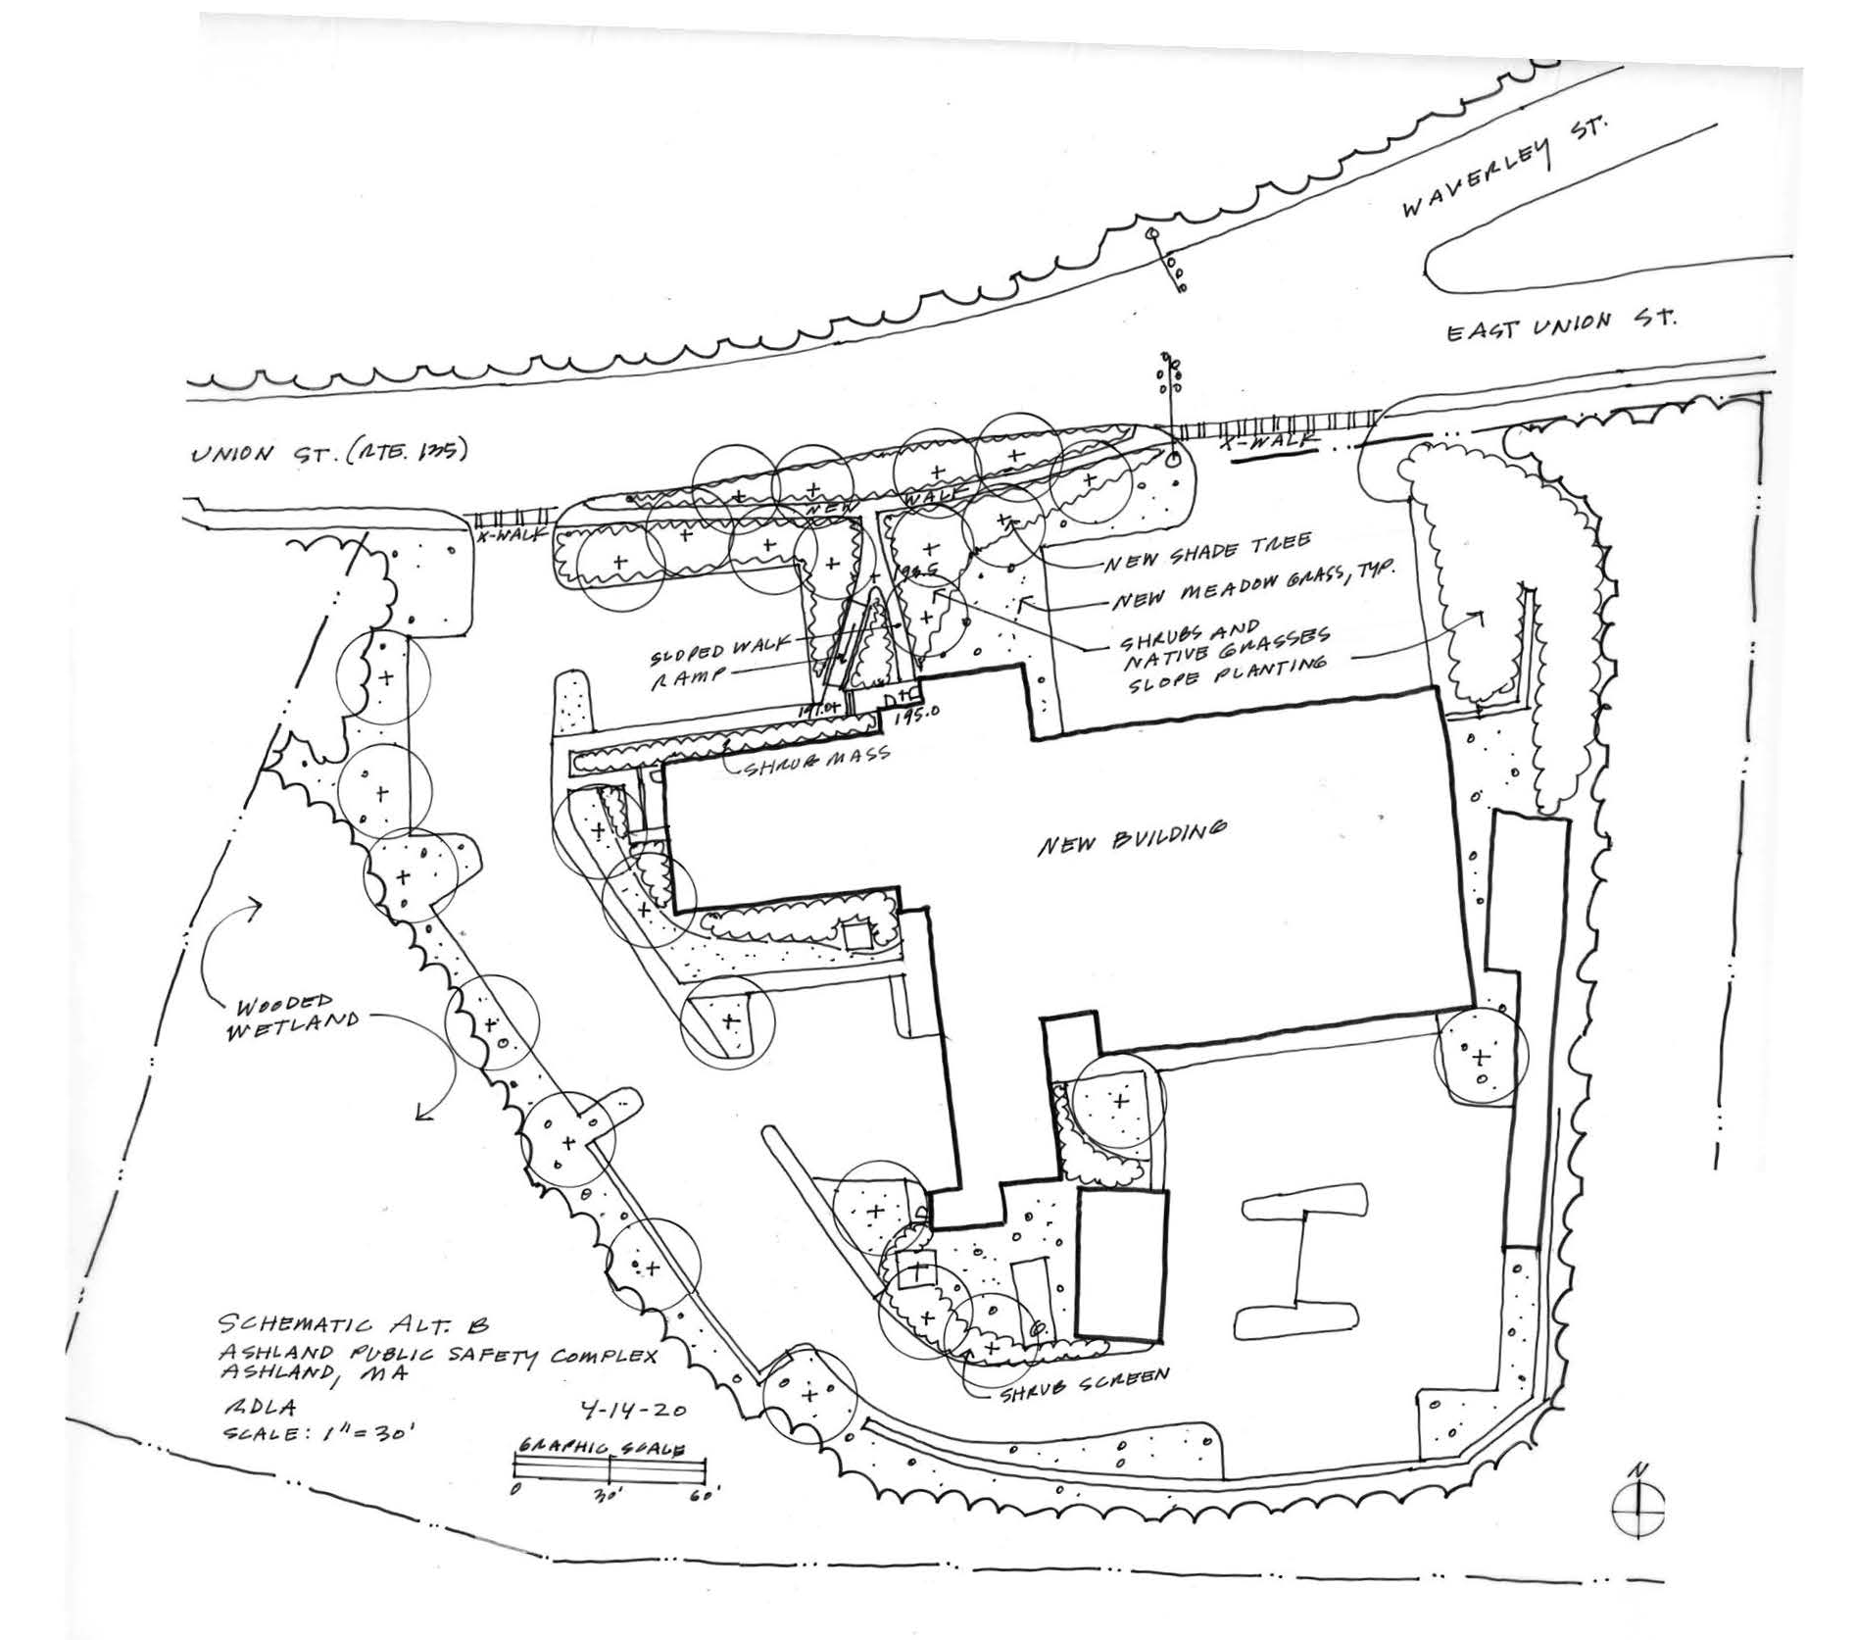
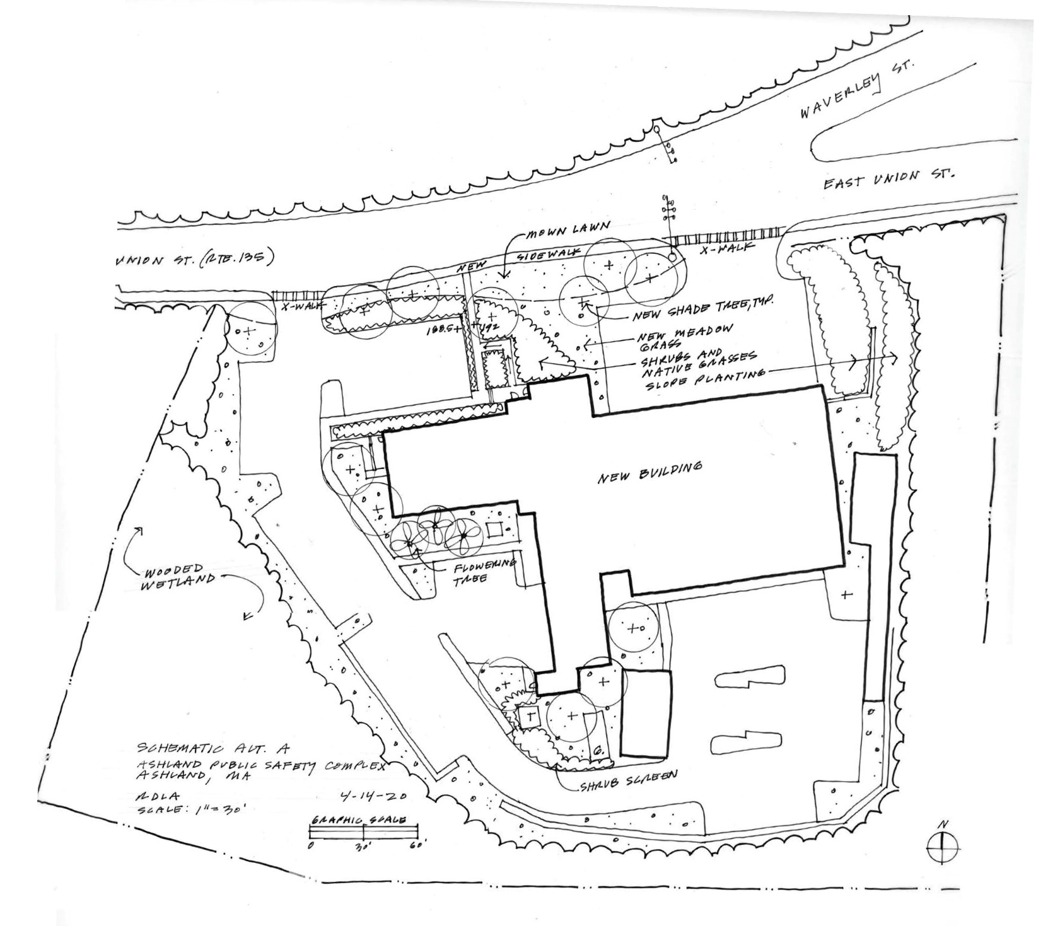
LANDSCAPE OPTIONS
OPTION B
OPTION A

Slide 5
TOTAL PROJECT COSTS – LEED / NET ZERO OPTIONS
LT - Location & Transportation – Electric Vehicle Charging – two charging stations and additional preferred parking for four vehicles – 1 Point
WE – Indoor Water Use Reduction – low flow plumbing fixtures + rainwater harvesting – Points TBD (2-4)
EA – Energy and Atmosphere
  Optimize Energy Performance – additional insulation + geothermal – Points TBD
  Renewable Energy Production – PV – 2-3 Points depending selected level (no added structures in cost)
  Advanced Energy Metering – 1 Point
IEQ – Thermal Comfort – Increased occupant control – 1 Point

Slide 6
LEED CHECKLIST ESTIMATES
Certified – 40-49 Points
Silver – 50-59 points
Gold – 60-79 points
Platinum
YES | ADD* | TOTAL | CATEGORY
1 | 1 | 2 | LOCATION AND TRANSPORTATION
2 | 0 | 2 | SUSTAINABLE SITES
3 | 2-4 | 5-7 | WATER EFFICIENCY
10 | 8-9+ | 18-19+ | ENERGY AND ATMOSPHERE
4 | 0 | 4 | MATERIALS AND RESOURCES
5 | 3 | 8 | INDOOR ENVIRONMENTAL QUALITY
1 | TBD | 1+ | INNOVATION
1 | 1 | 2 | REGIONAL PRIORITY
27 | 15-18+ | 42-45+ | TOTAL
*FOR LEED/NET ZERO OPTIONS & PREVIOUS MAYBE YES UPGRADES

Slide 7
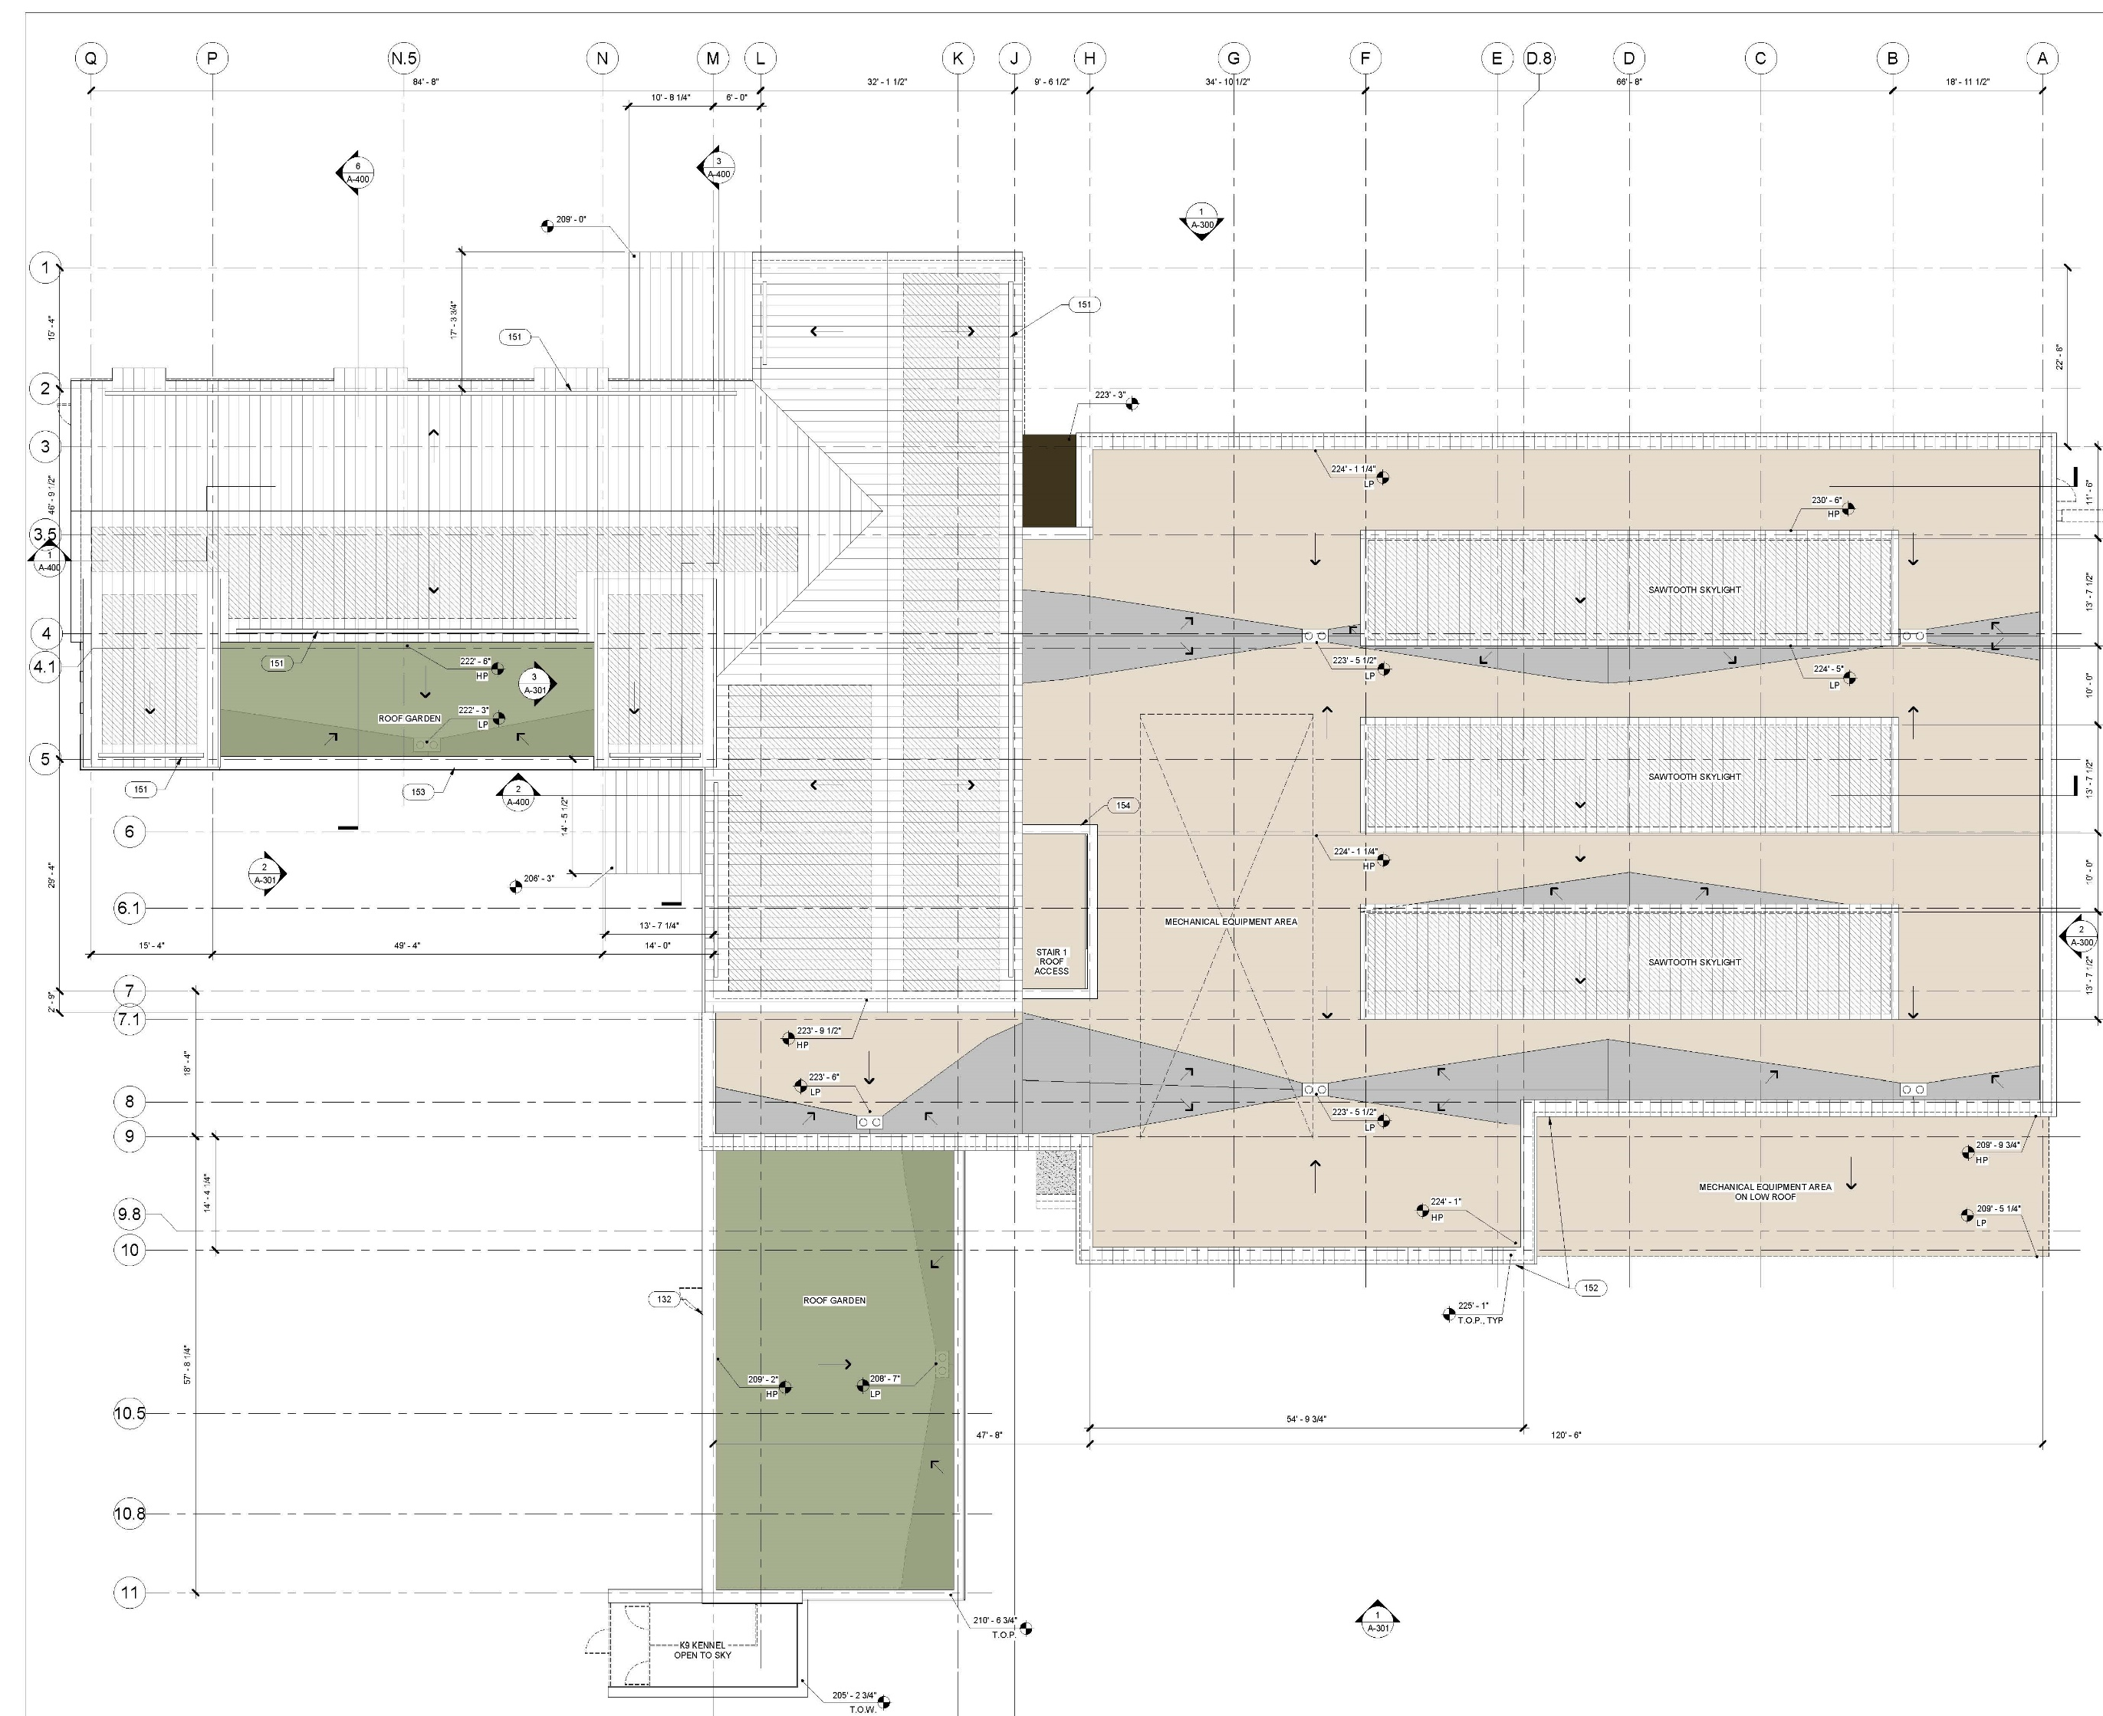
PV ANALYSIS
Yellow shaded areas have potential to produce 48.77 KW for $7,937/year in energy cost – approximately 7.62% savings in energy demand (2 LEED points)
To achieve 20% energy savings add 80KW (add 8,000sf south facing @ 10 degrees)
To achieve 40% energy savings add 210KW (add 21,000sf south facing @ 10 degrees)
To achieve 100% energy savings add 600KW (add 60,000sf south facing @ 10 degrees)
LEGEND:
MECHANICAL ZONES
GREEN ROOFS
POTENTIAL PV AREA

Slide 8
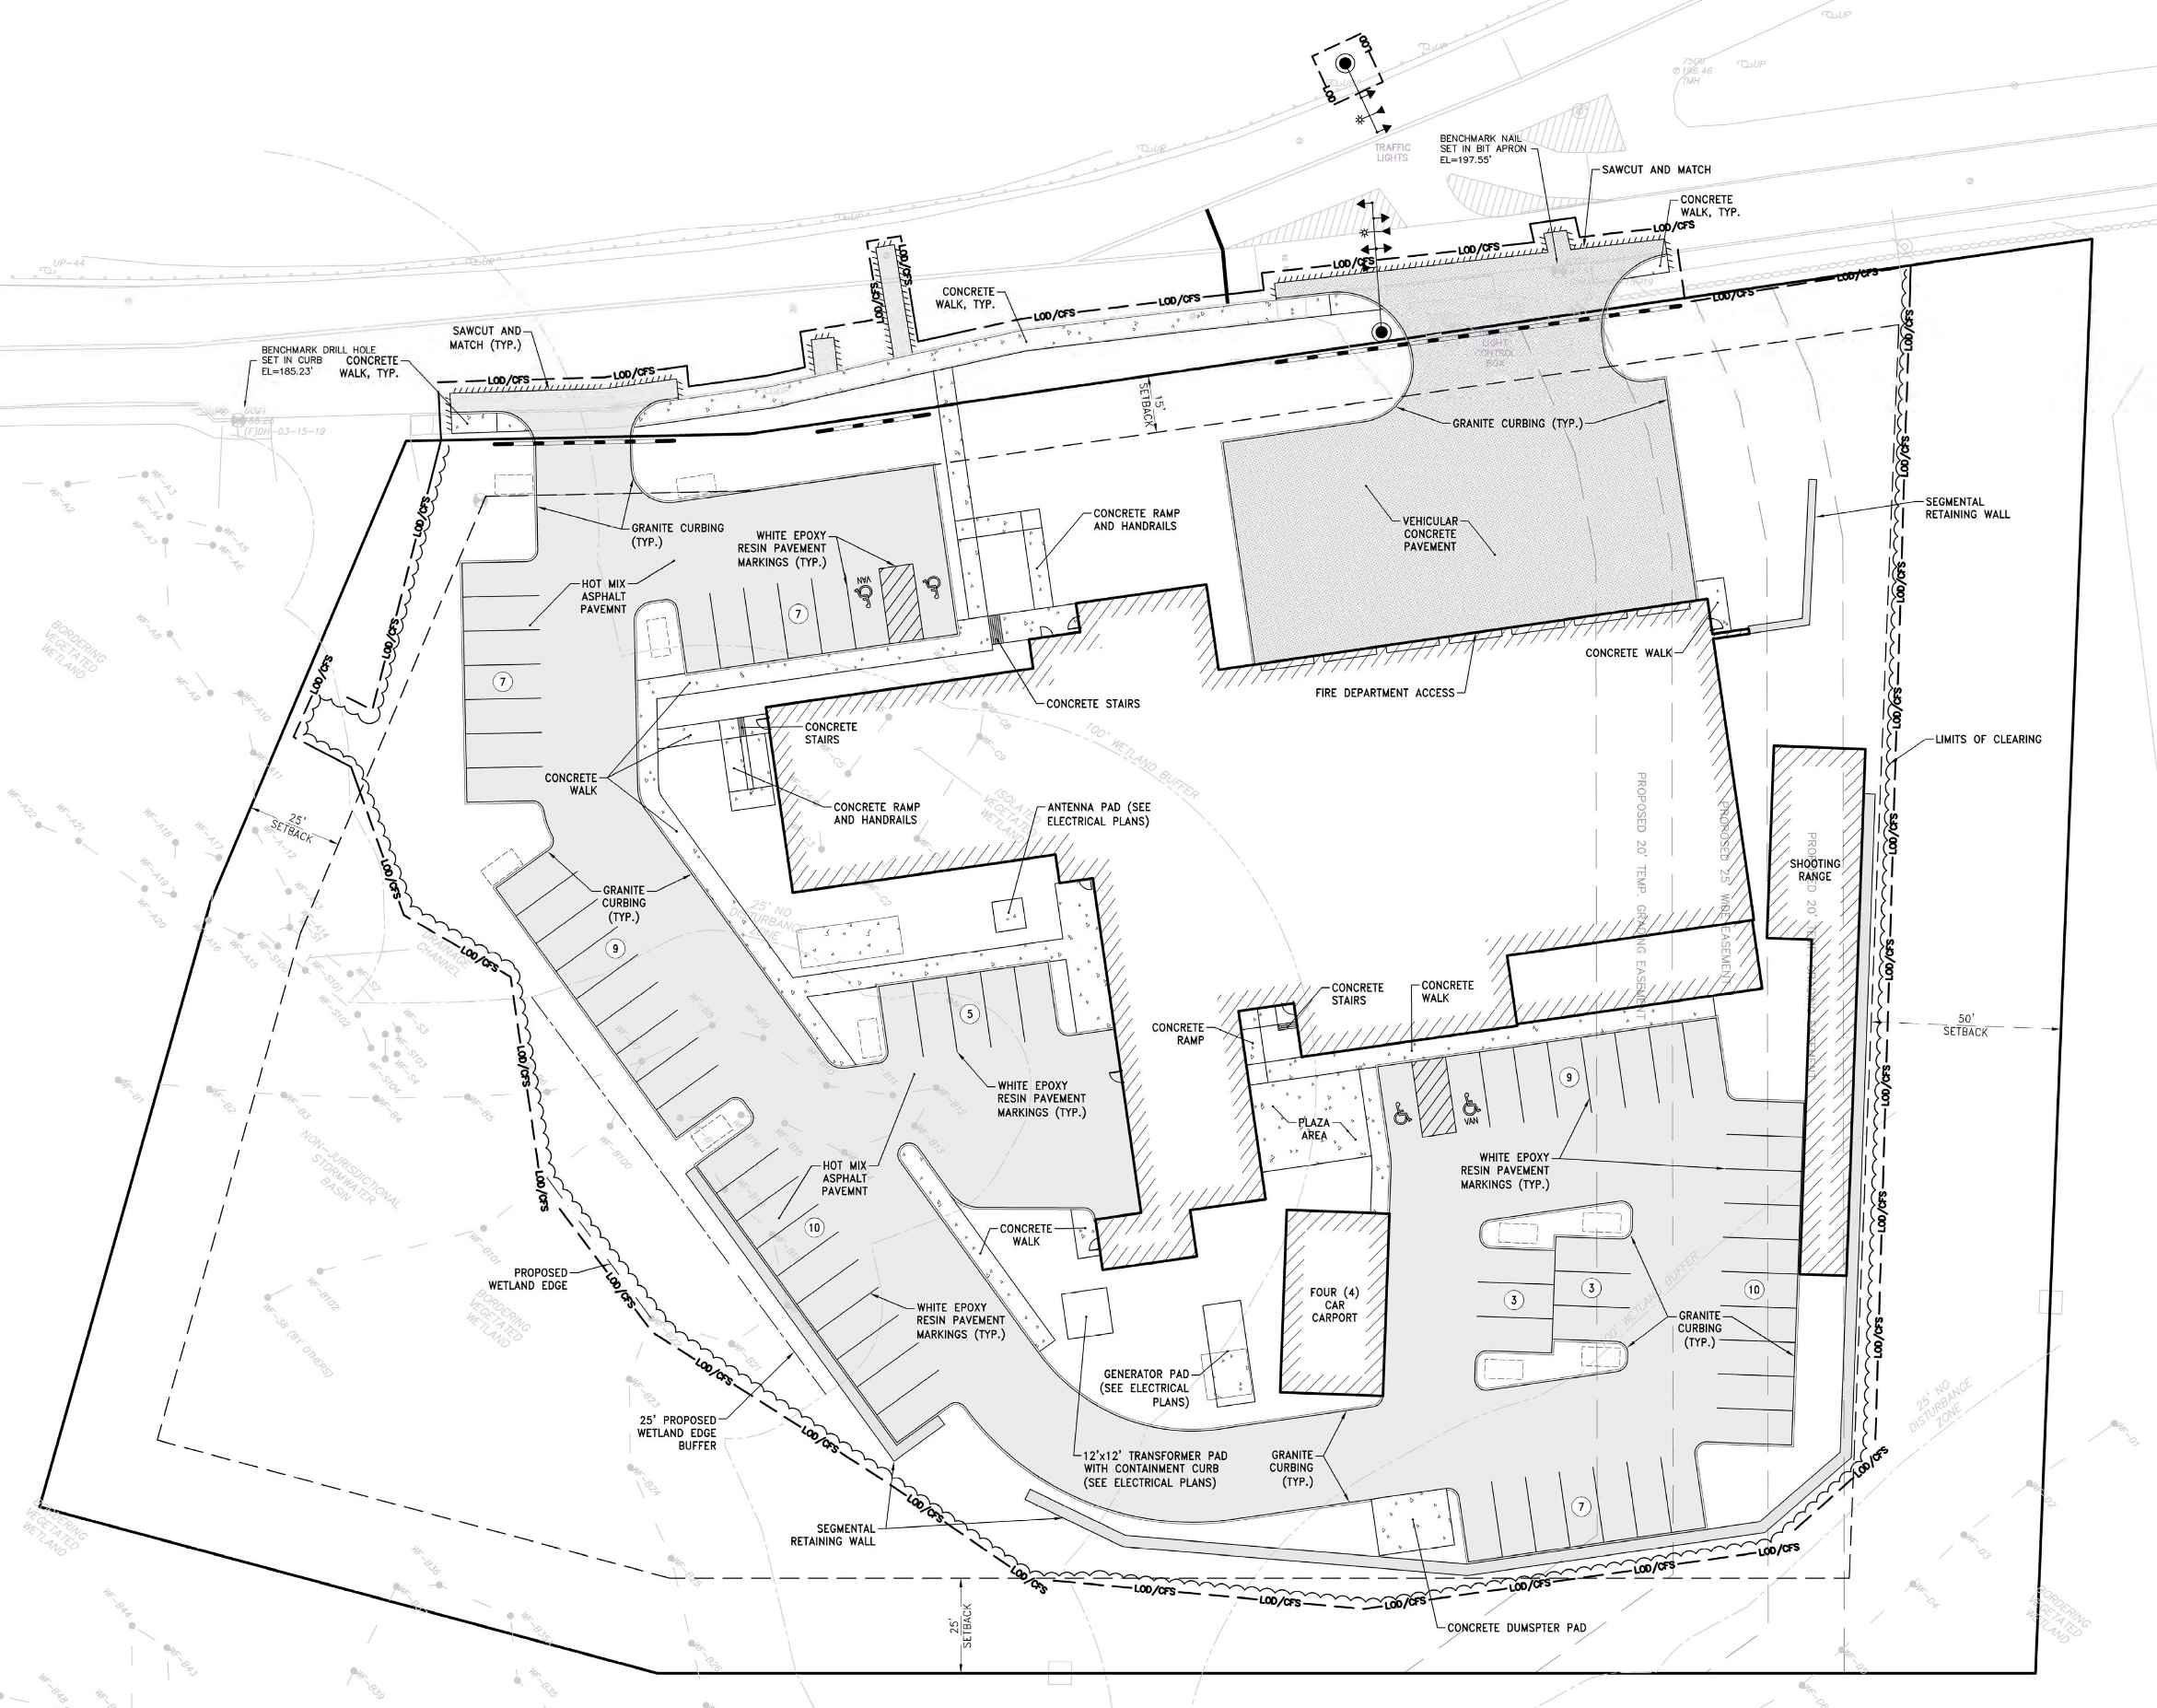
PV ANALYSIS
Yellow shaded areas have potential to produce 48.77
To achieve 20% energy savings add 80KW (add 8,000sf south facing @ 10 degrees) – add 1.65x yellow areas
To achieve 40% energy savings add 210KW (add 21,000sf south facing @ 10 degrees) – add 4.31x yellow areas
To achieve 100% energy savings add 600KW (add 60,000sf south facing @ 10 degrees) – add 12.3x yellow areas

Slide 9
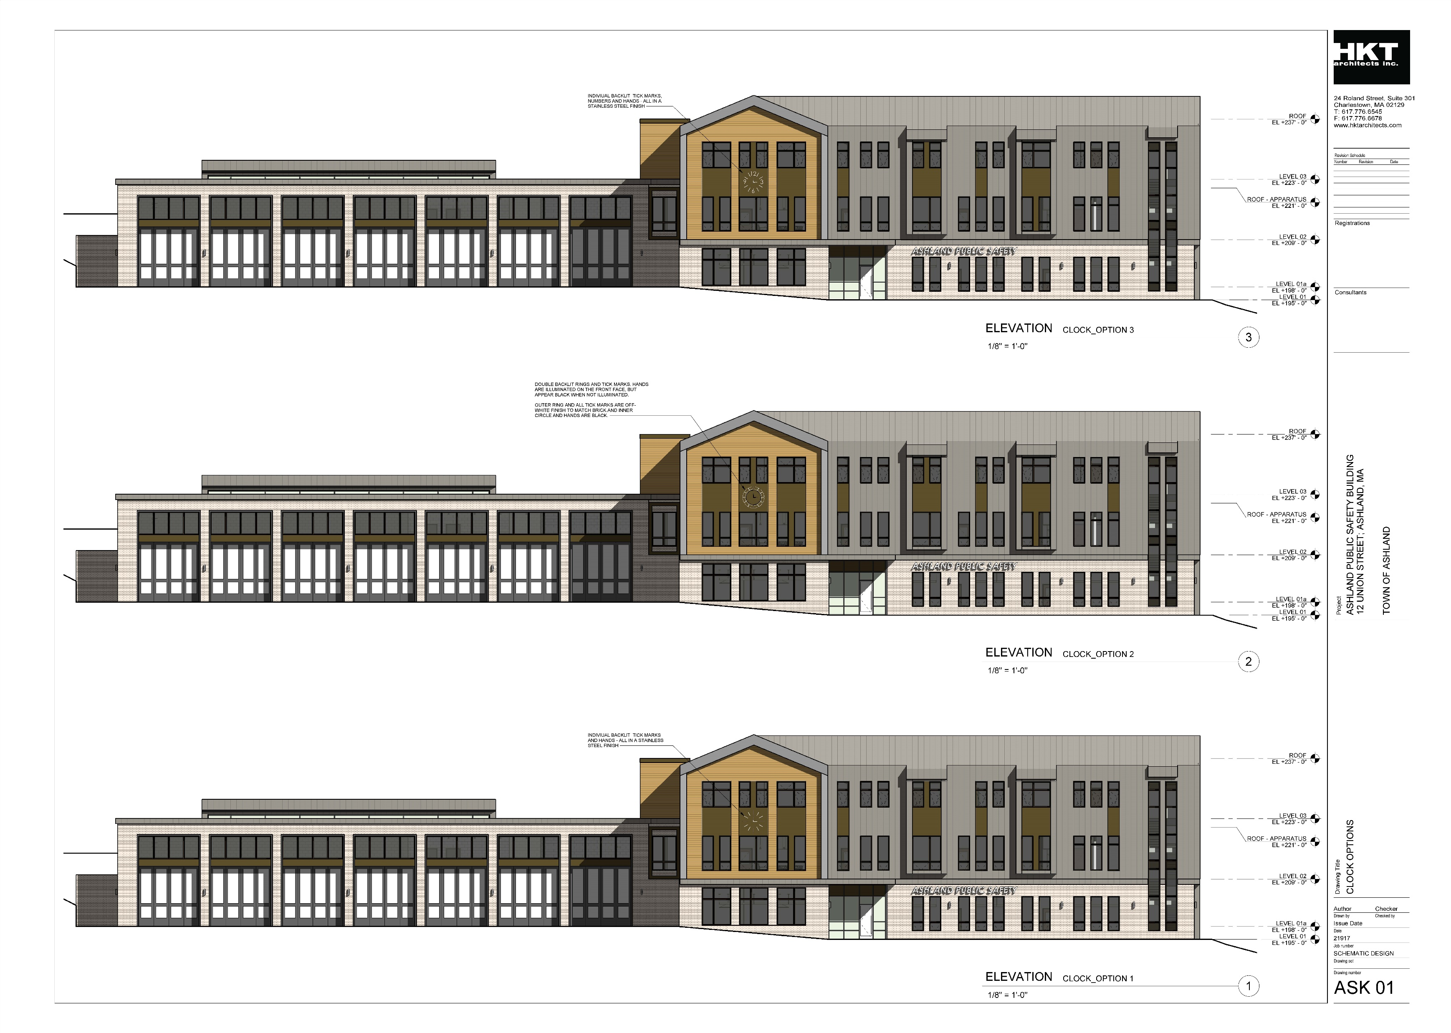
CLOCK OPTIONS

Slide 10
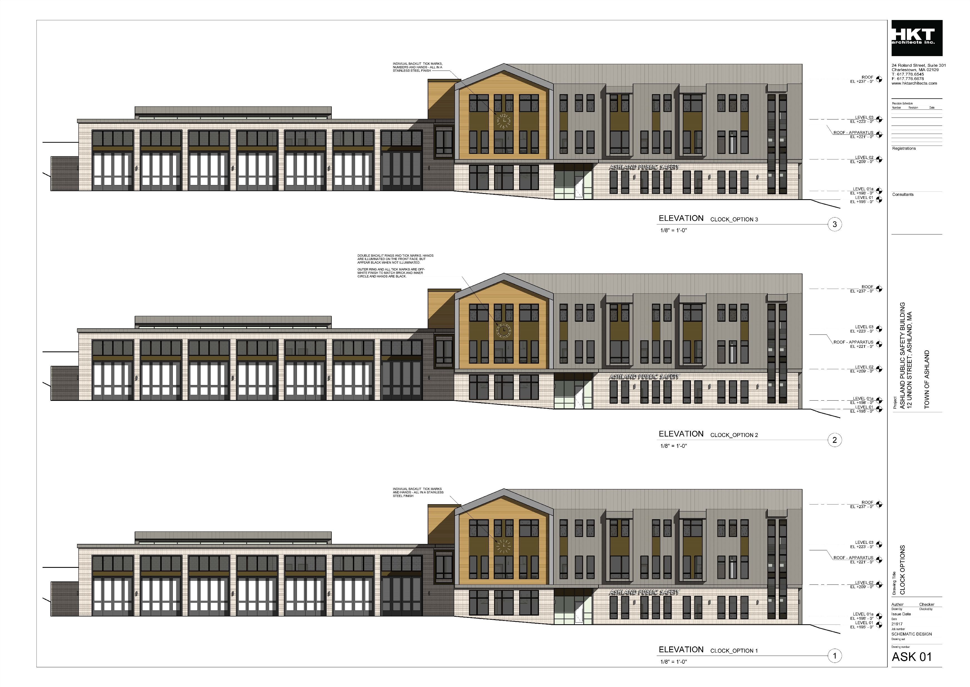
CLOCK OPTIONS
OPTION 1
OPTION 2
OPTION 3

